Slide 1
Rapid Covert Physical Entry
Daniel Crowley

Slide 2
Who am I?
Senior Security Engineer
Unhealthy preoccupation with unicorns
NCC Austin physical security guy

Slide 3
Agenda
Lock Internals
Quick & Dirty Lock Manipulation
Sight-Reading Lock Difficulty
Lock Bypass
BONUS ROUND: Recommended Tooling

Slide 4
Lock Internals

Slide 5
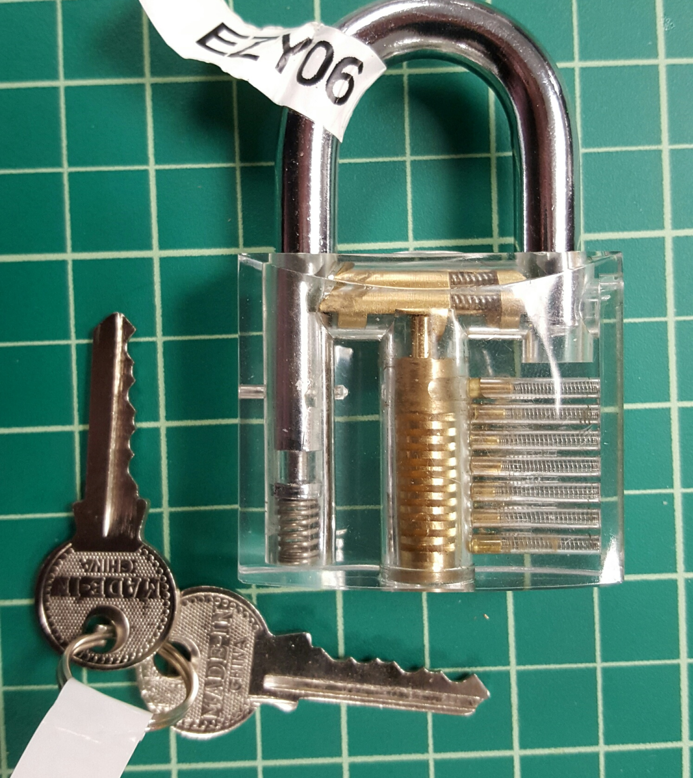
Lock Internals
Basic Components
Shackle
Dog / Bolt
Keyway
Key

Slide 6
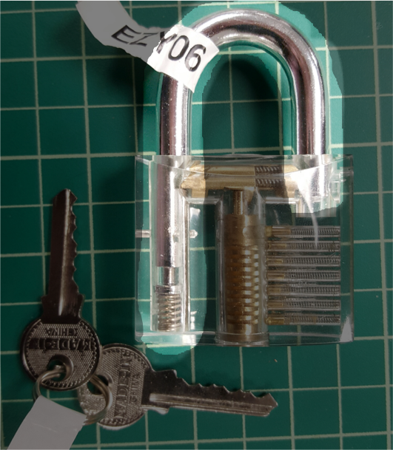
Shackle
Restricts asset movement
Target for destructive entry
Directly interacts with asset to be locked
Ultimately determines locked / unlocked state

Slide 7
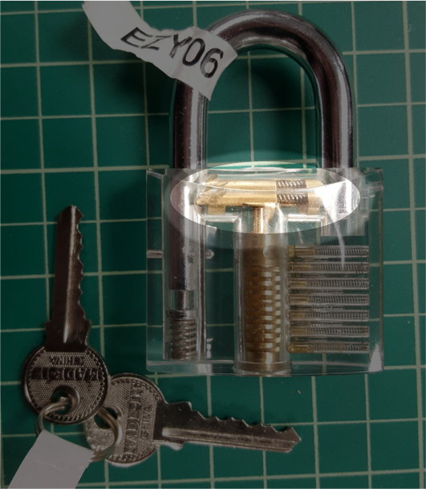
Dog / Bolt
Restricts shackle or asset
Target for manipulation
Movement should require key operation
Often doesn’t (see picture)
Sometimes can’t (single dial combination locks)

Slide 8
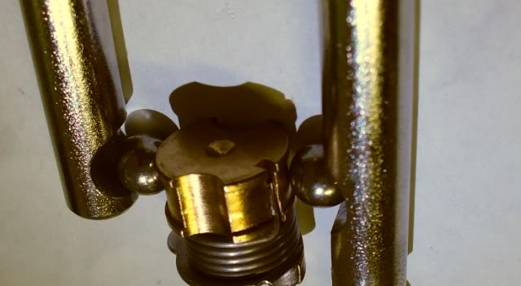
Ball Bearing Dog

Slide 9
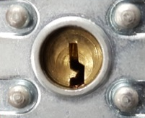
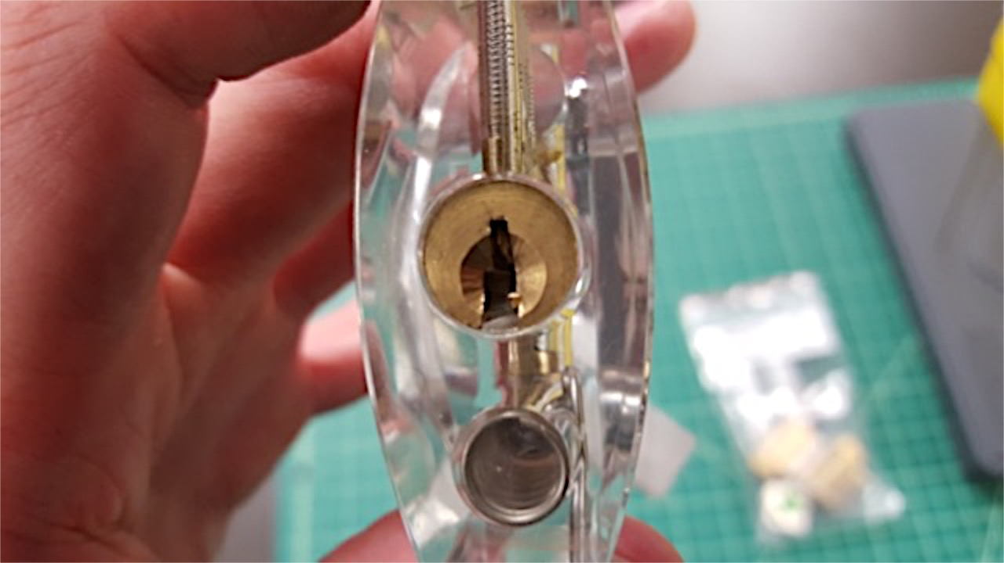
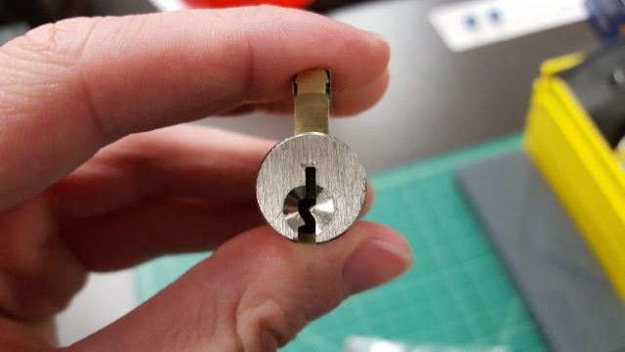
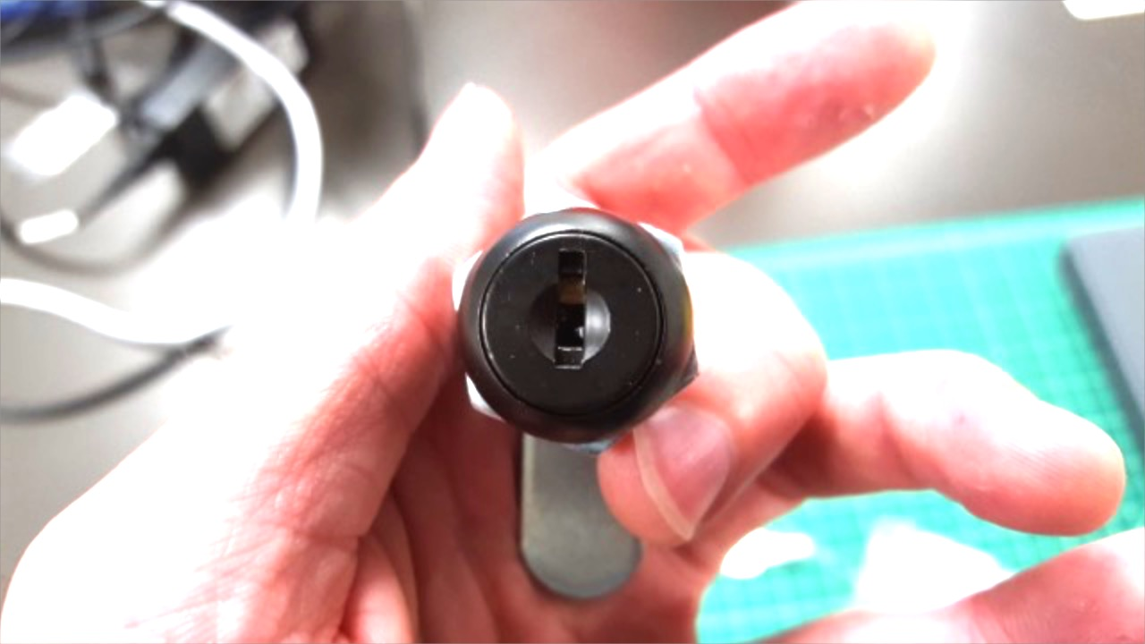
Keyway

Slide 10
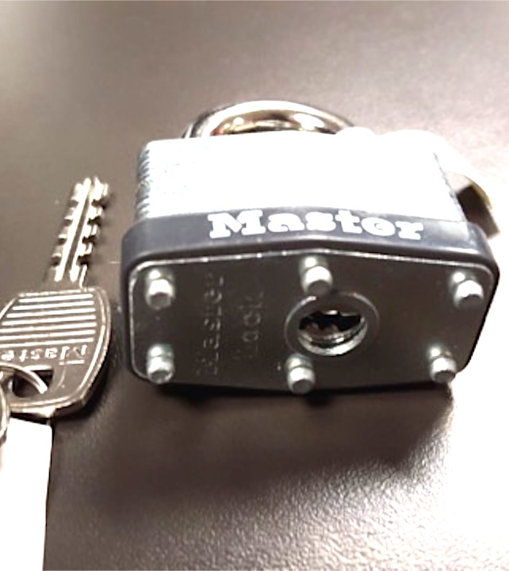
Warded Locks
Key actuates dog
Very simple mechanism
Pieces of metal (wards) obstruct incorrect key movement
Old design

Slide 11
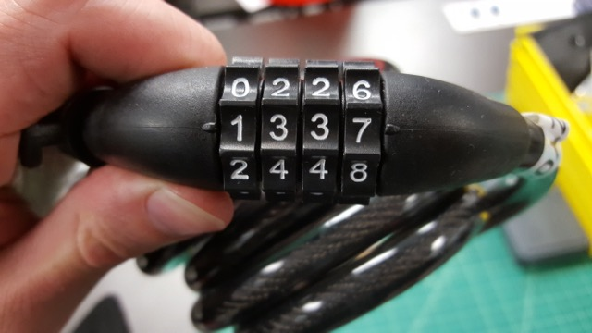
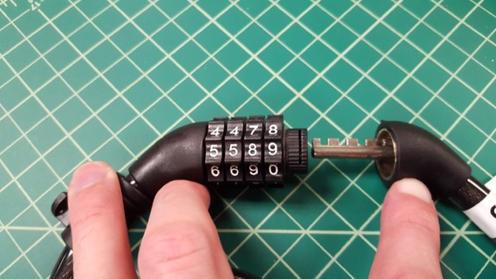
Multi-Wheel Combo Locks
Keyless design
2D torus-shaped disks with notches on inside
Toothed shackle / pawl

Slide 12
Single-Dial Combo Locks
Safes and your gym locker
VERY old design
Series of interlocking disks with notches
Correct disk rotation allows sidebar to fall into notches
Sidebar recessed into notches allows shackle movement

Slide 13
Lock Internals
Pin Tumbler Components
Plug
Bible
Pin stacks
Key and Driver pins

Slide 14
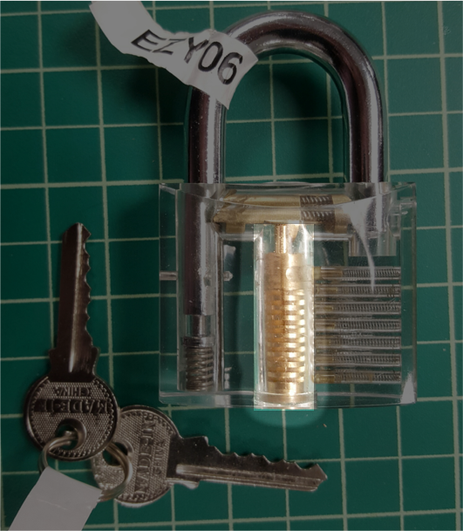
Plug
Actuates locking dog
Rotates inside lock
Directly interacts with dog
Usually the focus of lock hardening

Slide 15
Pin Stacks
Restricts plug movement
Each stack has:
Key pin
Driver pin
Spring
Master key pin (optional)
Correct key lifts pin stacks to right height
Usually 9 possible heights per pin

Slide 16
Pin Stacks
Restricts plug movement
Usually 4-6 pin stacks
Top view shown here
Not exactly accurate…

Slide 17
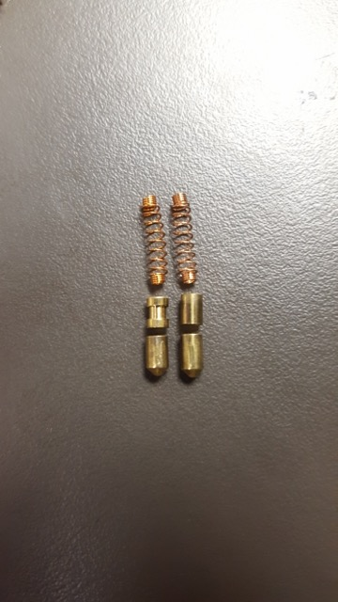
Pin Stacks
Pin stack components
Spring
Driver pin
Security pins
Key pin

Slide 18
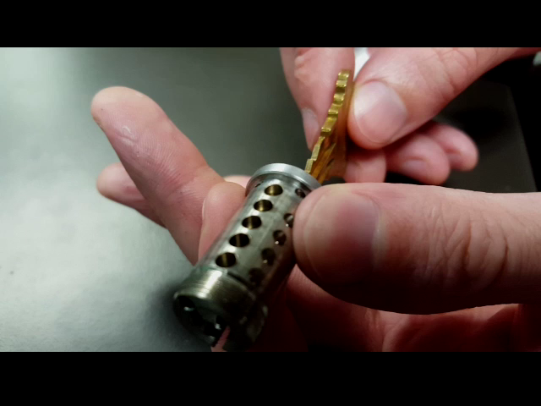
Pin Stacks
Normal key operation
Video shows removed plug and key pins

Slide 19
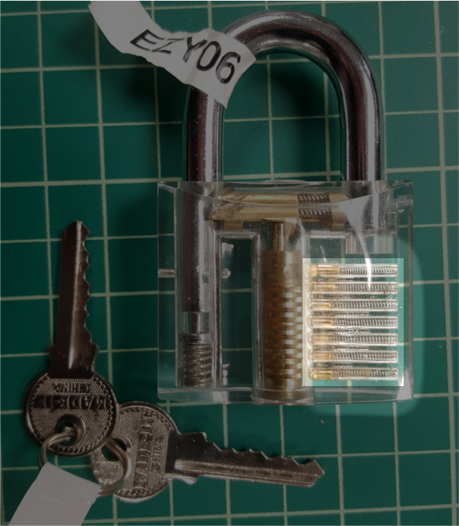
Bible
Holds pin stacks
Overly large bible may allow attacks
Allows pins to retract from plug
Springs push pins into plug

Slide 20
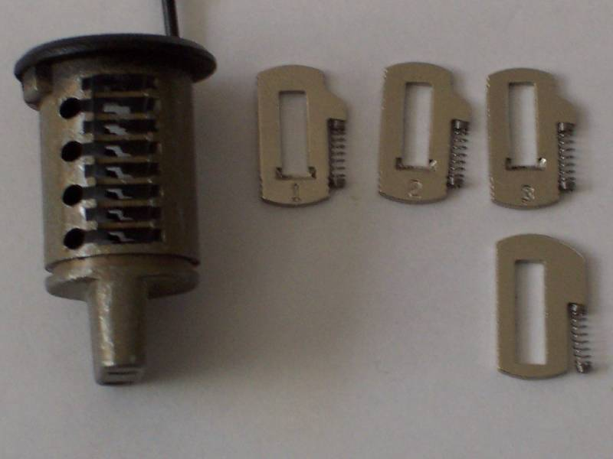
Wafer Locks
Wafers, not pins
Cheaper to produce
Terrible quality

Slide 21
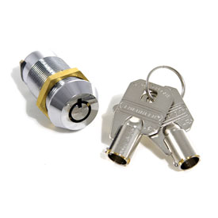
Tubular Locks
Pin tumbler, but tubular
Pins are pushed into lock
Pins arranged in circle
Same overall concept

Slide 22
Agenda
Lock Internals
Quick & Dirty Lock Manipulation
Sight-Reading Lock Difficulty
Lock Bypass
BONUS ROUND: Recommended Tooling

Slide 23
Q&D Lock manipulation

Slide 24
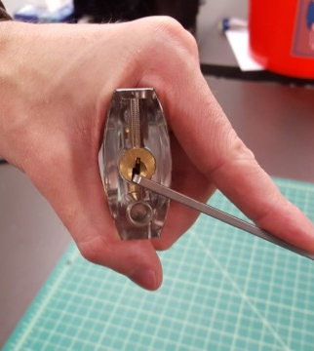
Lock Raking
Apply torque to plug
Put pick in keyway
Go fscking nuts
???
OPEN!

Slide 25
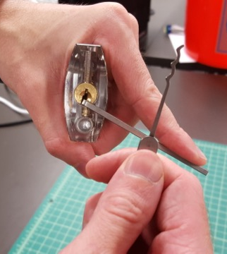
Lock Raking
Apply torque to plug
Put pick in keyway
Go fscking nuts
???
OPEN!

Slide 26
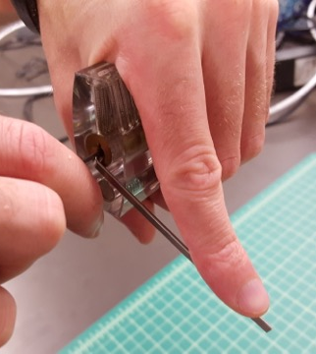
Lock Raking
Apply torque to plug
Put pick in keyway
Go fscking nuts
???
OPEN!

Slide 27

Lock Raking
Apply torque to plug
Put pick in keyway
Go fscking nuts
???
OPEN!

Slide 28
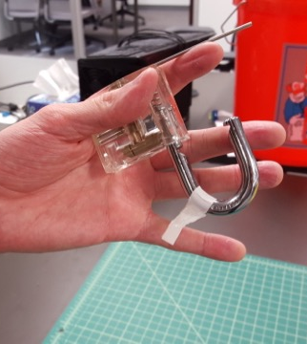
Lock Raking
Apply torque to plug
Put pick in keyway
Go fscking nuts
???
OPEN!

Slide 29
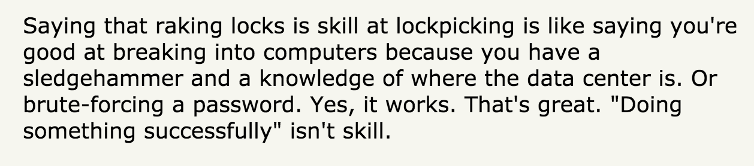
Lock Raking Haters
Taken condescendingly from Hacker News comments

Slide 30
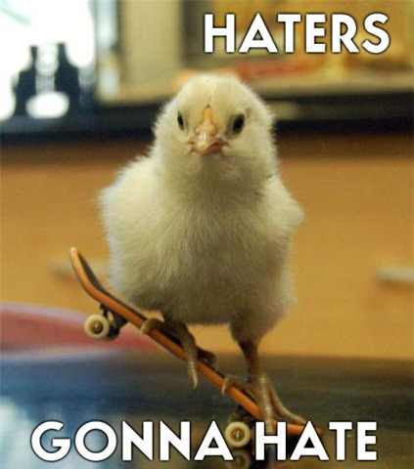
Lock Raking Haters
“If it’s stupid and it works, it ain’t stupid.”

Slide 31
What just happened?
Remember the pin stacks
Pins are not aligned perfectly

Slide 32
What just happened?
Remember the pin stacks
Pins are not aligned perfectly
Manufacturing limitations
Applying torque pinches pins from farthest left to farthest right
Or right to left, if turning counter-clockwise

Slide 33
What just happened?
SPP involves lifting each pinched (“binding”) pin
Identify binding pin
Lift pin to correct height
Lifted pin held up by small ledge of rotated plug
Repeat until all pins at correct height
Raking/jiggling/rocking is random movement and luck

Slide 34
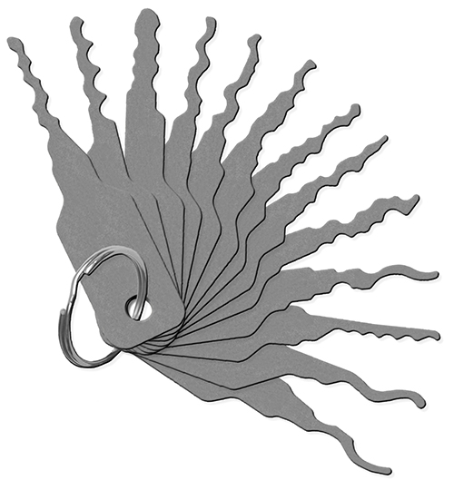


Lock Jiggling

Slide 35
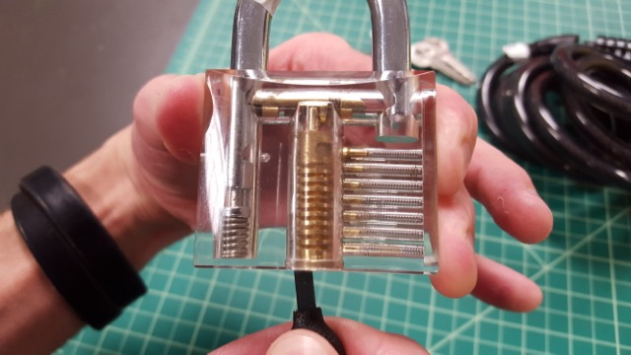
Direct Dog Manipulation
Move dog directly
Via keyway

Slide 36
Direct Dog Manipulation
Move dog directly
Via keyway

Slide 37
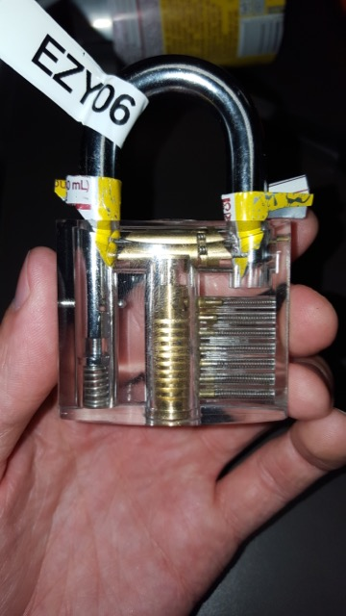
Direct Dog Manipulation
Move dog directly
Via keyway
Around shackle

Slide 38
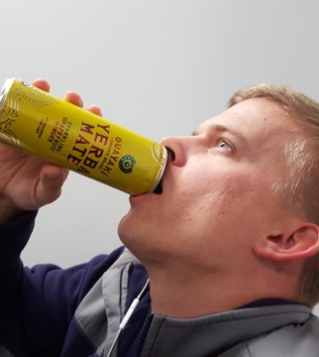
Making Padlock Shims
Drink your favorite canned beverage
Cut off bottom and top and make a sheet
Cut off a rectangle
Cut out a sine wave pattern
Fold down top, wrap prongs around
Curve shim

Slide 39
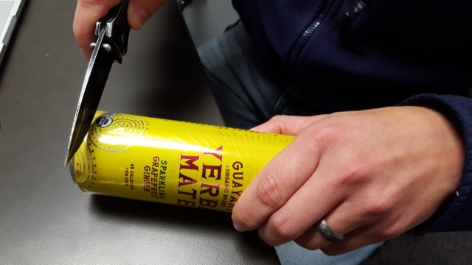
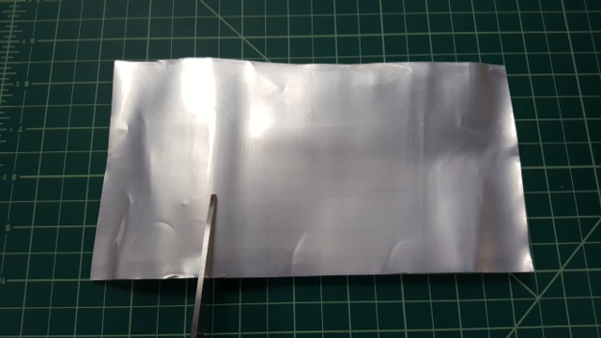
Making Padlock Shims
Drink your favorite canned beverage
Cut off bottom and top and make a sheet
Cut off a small rectangle
Cut out a sine wave pattern
Fold down top, wrap prongs around
Curve shim

Slide 40
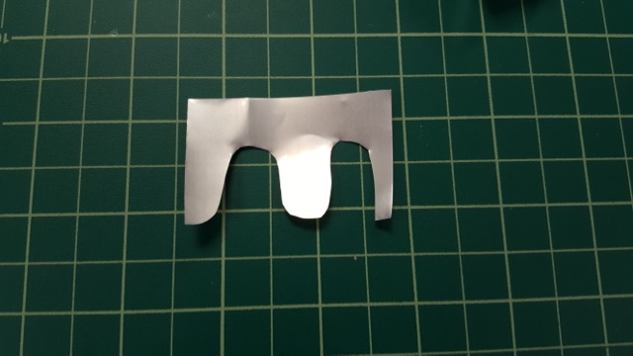
Making Padlock Shims
Drink your favorite canned beverage
Cut off bottom and top and make a sheet
Cut off a rectangle
Cut out a sine wave pattern
Fold down top, wrap prongs around
Curve shim

Slide 41
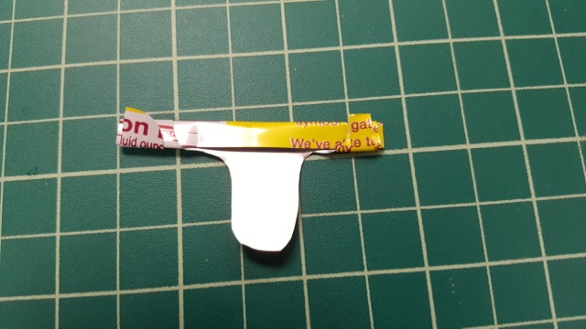
Making Padlock Shims
Drink your favorite canned beverage
Cut off bottom and top and make a sheet
Cut off a rectangle
Cut out a sine wave pattern
Fold down top, wrap prongs around
Curve shim

Slide 42
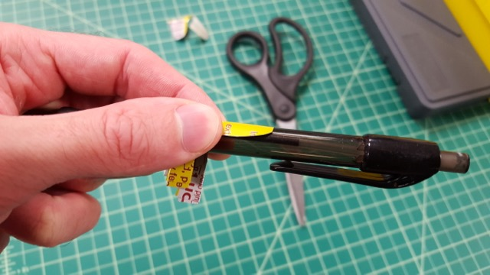
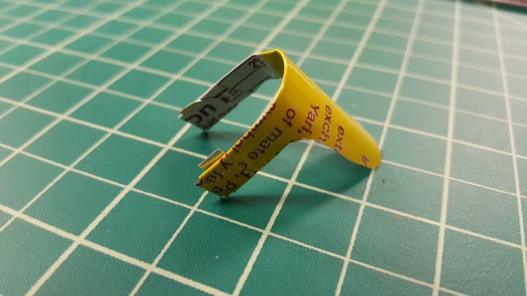
Making Padlock Shims
Drink your favorite canned beverage
Cut off bottom and top and make a sheet
Cut off a rectangle
Cut out a sine wave pattern
Fold down top, wrap prongs around
Curve shim

Slide 43
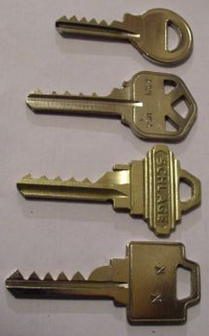
Bump Keys
Key blank cut to lowest bitting
When “bumped” into lock, pops driver pin up
Imagine pool or croquet balls
!!! May be illegal to own where you live !!!

Slide 44
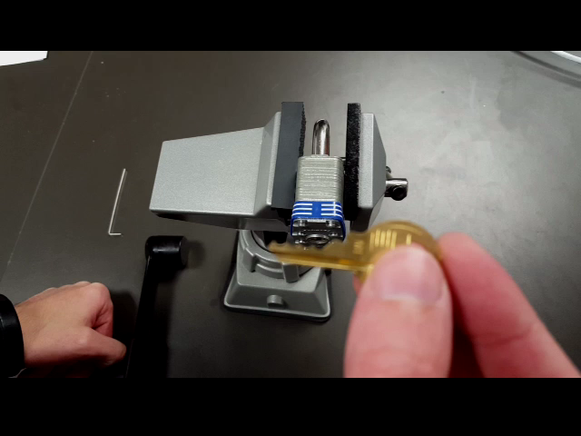
Bump Keys
Bump key operation
Insert key into lock
Pull key out one notch
Apply slight torque
Apply quick inward force on bump key

Slide 45
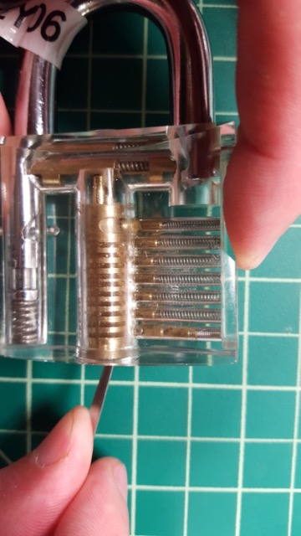
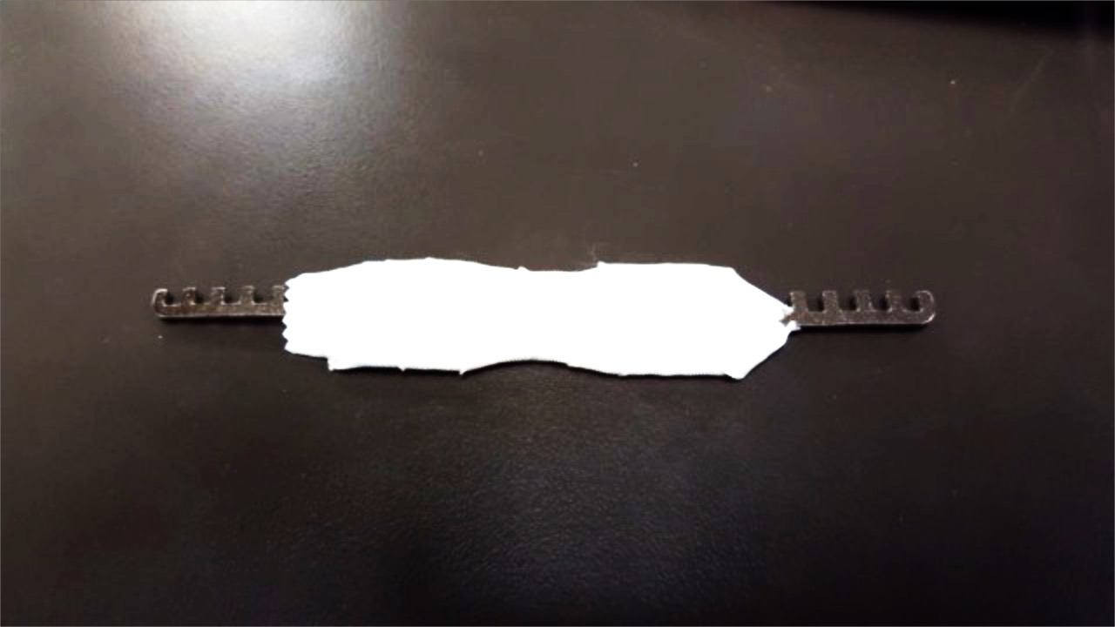
Comb picking
Push pins completely out of plug
Requires overly large bible
Security pins don’t matter
Works well with solid body padlocks

Slide 46
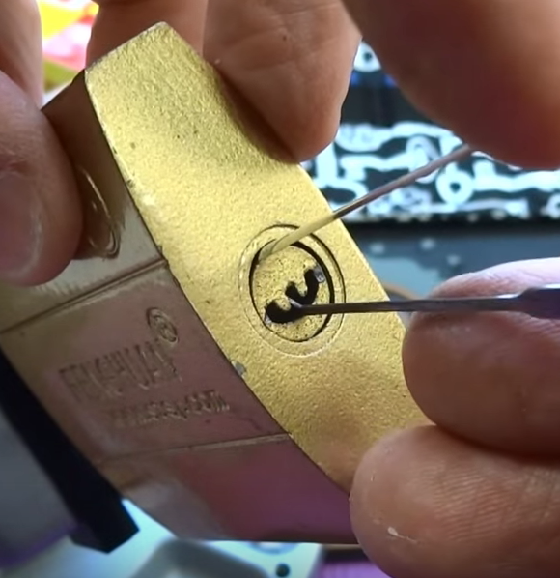
Core / Bible shimming
Attack poor plug fit
Slip shim between core and bible
Pick each pin individually
Situation-specific refinement on lock picking
Image taken from BosnianBill
https://youtube.com/user/bosnianbill

Slide 47
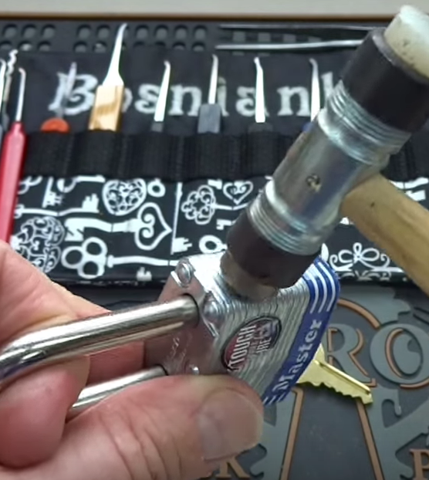
Kinetic Attacks
Hit it
But all special like
Not a euphemism for destructive entry
Actuates internal components using inertia
Photo from BosnianBill

Slide 48
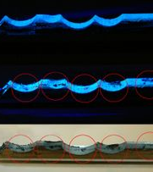
Impressioning
Create a key using the lock
Uses “binding pin” principle of lock picking
Binding pin creates scratches in key blank
Takes time and patience for all but the super-elite

Slide 49
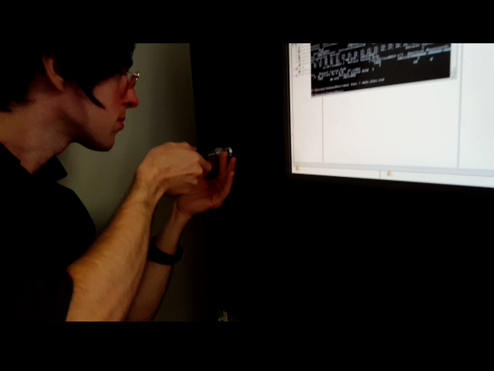
Tubular Lock Impressioning
Far easier and quicker
Effective at opening locks
Can use fancy $85 tubular picks
Can use a business card, scissors and tape

Slide 50
Agenda
Lock Internals
Quick & Dirty Lock Manipulation
Sight-Reading Lock Difficulty
Lock Bypass
BONUS ROUND: Recommended Tooling

Slide 51
Sight-Reading locks

Slide 52
Lock Difficulties
Easy
Medium
Hard
NOPE
Quick to open with little training
Opens reliably with some training or special tools
Will not open quickly but given lots of time and training, could be done
If you have to ask, you can’t open it

Slide 53
Caveat!
The locks mentioned are mostly US-centric

Slide 54

Easy

Slide 55
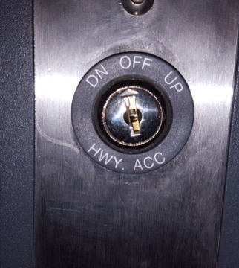
Wafer Locks
Wafer locks are cheap
Cheap manufacturing means easy picking
Very few high security wafer locks

Slide 56
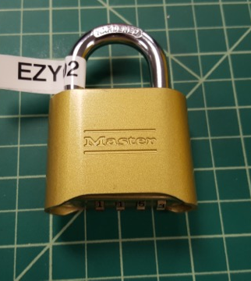
Master Locks
Easily picked
Few notable exceptions
Lots of bypasses
Master #175
Master #14x
Master #1,3,5
Model number etched near keyway

Slide 57
Tubular Locks
Usually very easy
A few are very hard!
Impressioning very effective, powerful, fast

Slide 58
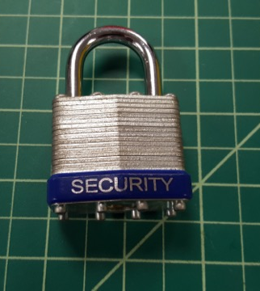
No-Name Locks
Tough to pick
Shoddy construction
Almost always a bypass
Shank it
Shim it
Rap it

Slide 59
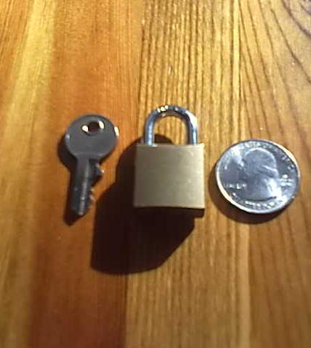
Tiny Locks
Hard to manufacture
Requires compromises
Security features often missing
Shim it
Shank it
Snip it
Image from Photobucket user 883xl

Slide 60
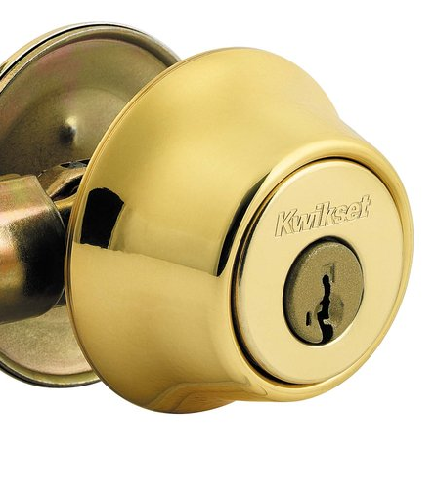
Kwikset Classic
Super common door locks
No security pins
Easy to rake open
Bypasses for most Kwiksets

Slide 61

Medium

Slide 62
Kwikset SmartKey
Can be identified by hole to side of keyway
Hard to pick
Easy and cheap to decode, but takes time
Can be partially destroyed to directly actuate

Slide 63
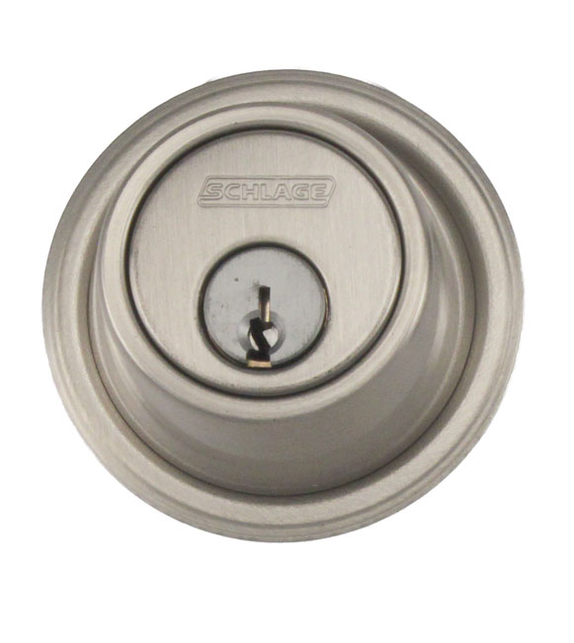
Schlage Classic
Annoying keyways
Mostly spool pins
With picking practice, opened quick enough

Slide 64
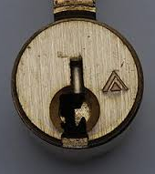
Schlage Everest
An attempt at high security
A failed attempt
Contains a single “check pin”
Identical bitting across Everest locks
No security pins!

Slide 65
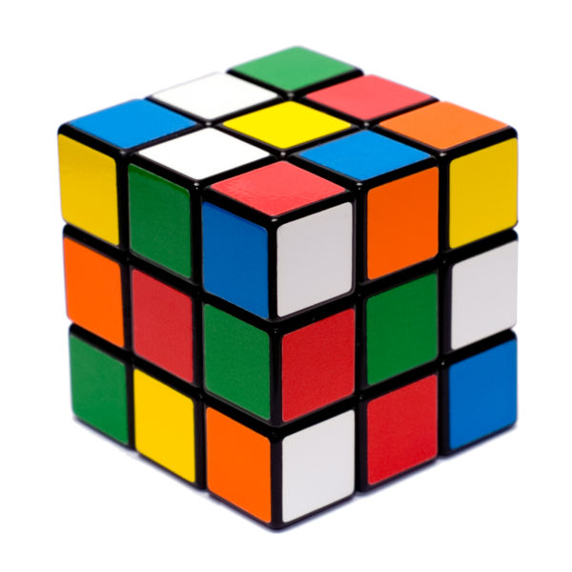
Hard

Slide 66
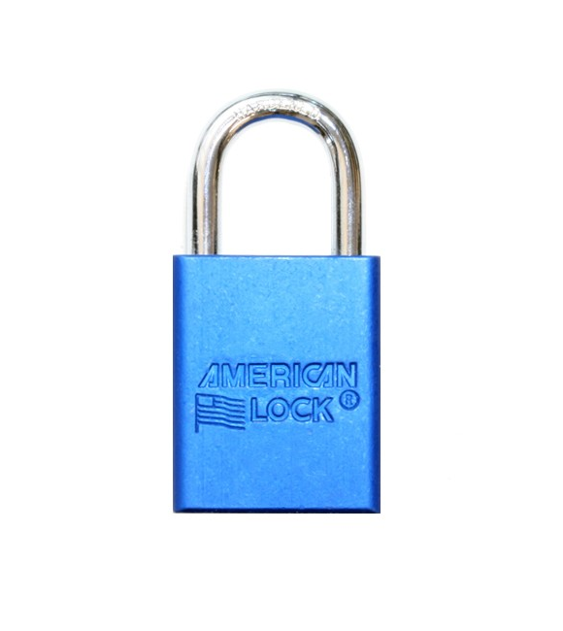
American Lock
Different types of security pins
Serrated pins are hell on earth

Slide 67

SFIC
Interchangeable core
One key opens lock
Another key removes core
Normal picking yields success 1 in 2^{(pins-1)}
Intentional overlifting attack

Slide 68

Disc Detainer
Works like single-dial combo locks
Discs are rotated by angle-cut key
Difficult to manipulate in general
Most models are high-security

Slide 69

NOPE

Slide 70

Medeco
Awful keyways
Biaxial design
Security pins
Well-made
No known bypasses

Slide 71

Schlage Primus
Six normal pins up top
Sidebar with six finger pins
Must be lifted AND rotated like Medeco pins

Slide 72
Lock bypass

Slide 73

Loiding
The “credit card” trick
Directly actuate latch
Push or pull with
Credit card
Hotel room key
Slim jim
Mica shim
Latch guards
Wedges and levers (rubber, air, crowbar)

Slide 74


Under the Door
Under the door tool shown here
Exploits fire code
Exploits disability protections

Slide 75

Disassembly
Sometimes you don’t need a key…
…Just a screwdriver

Slide 76

Environmental Failure
Sometimes you don’t need a key…
…Just spatial skills

Slide 77

Alternative entry point
Sometimes you don’t need a key…
…Just common sense

Slide 78
The End?
Daniel “unicornFurnace” Crowley
Daniel.Crowley@nccgroup.trust

Slide 79
Recommended tooling

Slide 80

Recommended Tooling

Slide 81

Picks
TOOOL/Southern Specialties
Tremendous Twelve $30
PRO
Great torque wrenches
Falle hook
Hooked diamond
CON
Single-peak bogota
Large half diamond

Slide 82

Picks
Sparrows
Tuxedo $40
PRO
Hooked diamond
City rake
Double-headed torque wrenches
Low profile case
CON
Cheap handles

Slide 83

Picks
Peterson
Ken’s Pick Set $82
PRO
Great materials
Hard plastic handles
Comes w/ shank tool
CON
Price
Too many hooks
Peterson is a jerk

Slide 84

Picks
Longhorn Lockpicking
Basic Pick Set $?
PRO
Only what you need
Solid steel handles
Instant gratification
CON
Nothing fancy
One torque wrench

Slide 85

Bypass Tools
Sparrows
Orion $25
PRO
Flat and tubular torque wrenches
Comb picks
Shank
CON
Awkward handles for comb picking and shanking

Slide 86

Bypass Tools
Rift Recon
Under the Door tool 2.0 $50
PRO
Folds up to backpack size
CON
Wire-side handle gets painful with repeated use
Really simple tool
Make your own?

Slide 87

Bypass Tools
BROCKHAGE
Stiff Air Wedge $30
PRO
Stiff edge for easy insert
Non-slip coating

